Slide 1
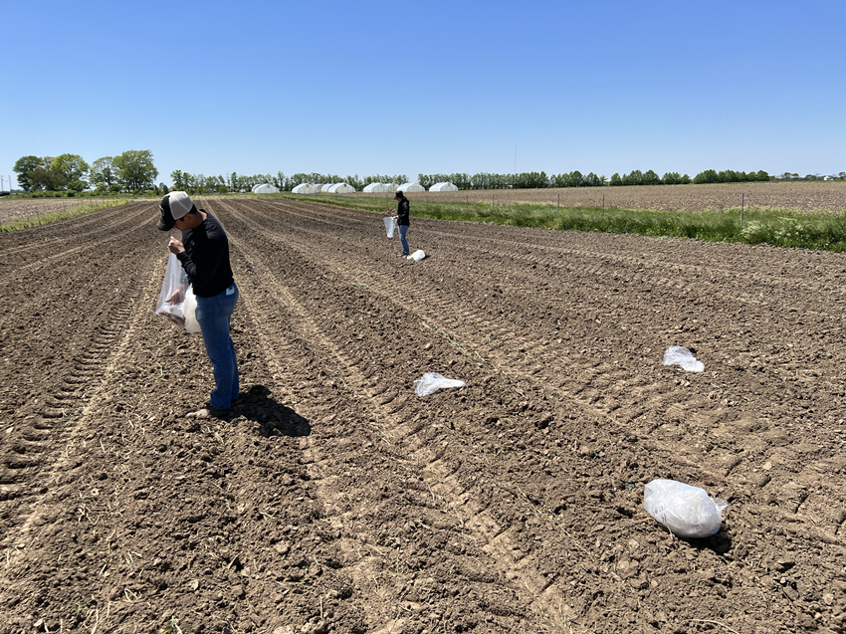
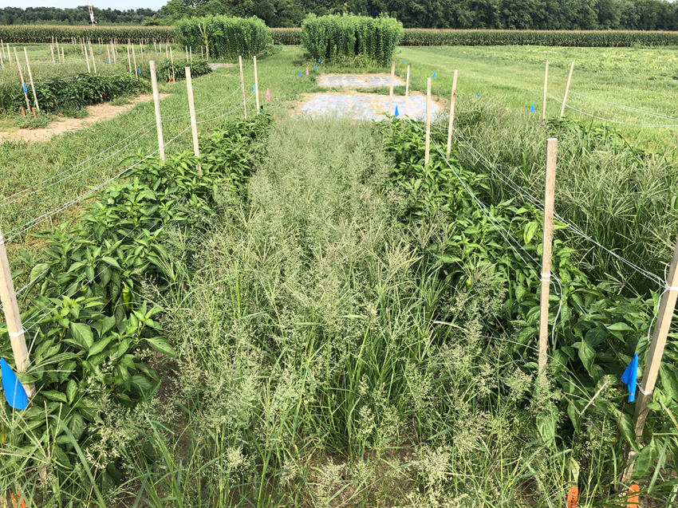
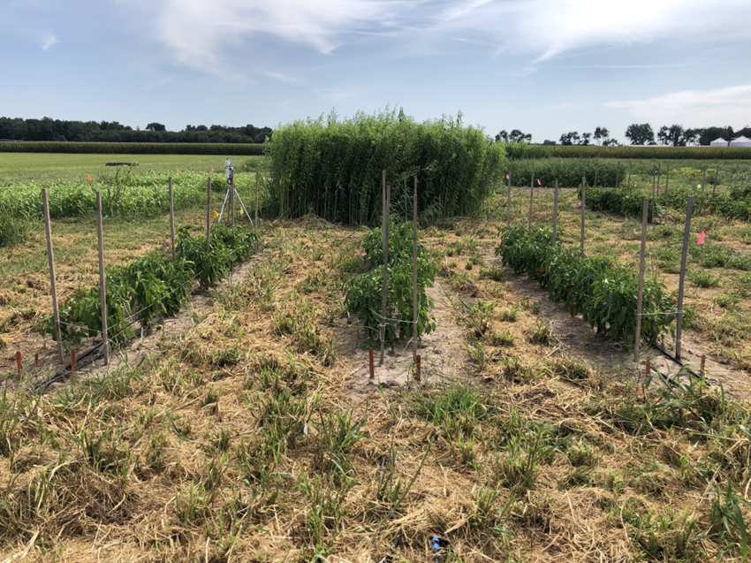
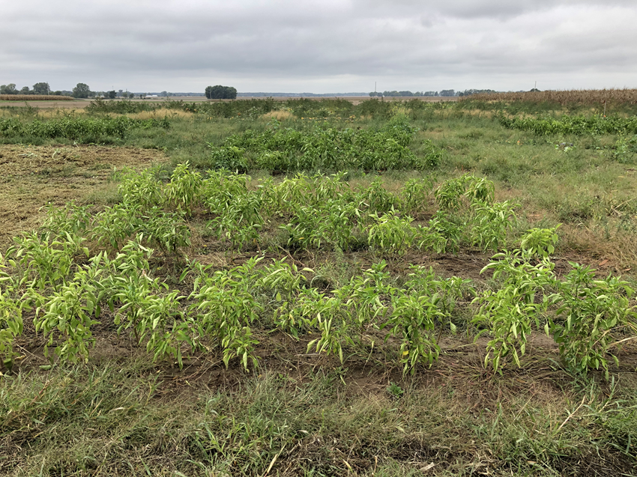
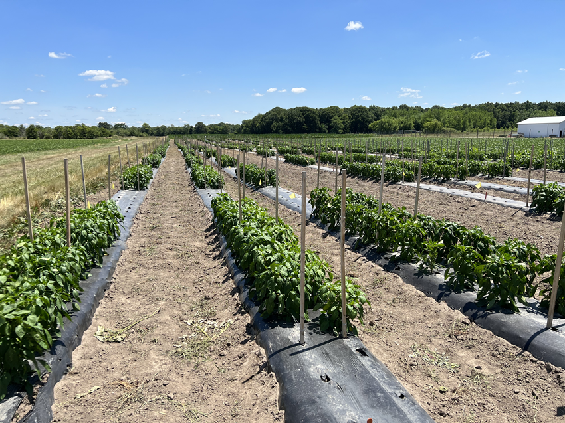
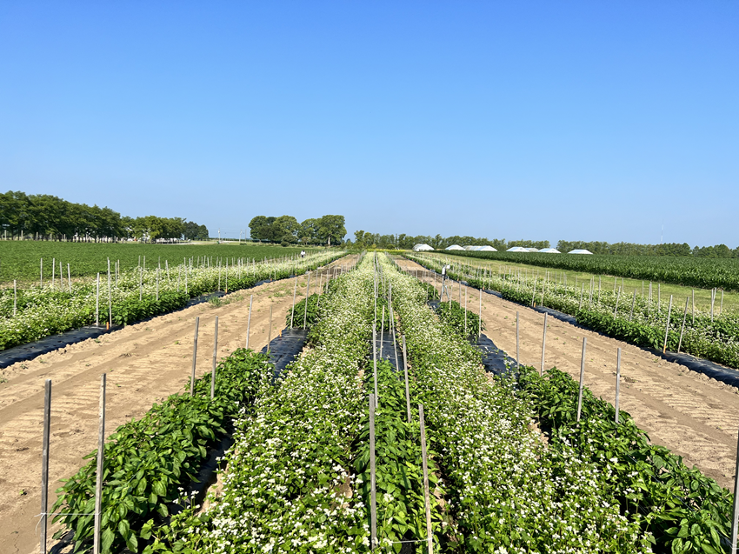
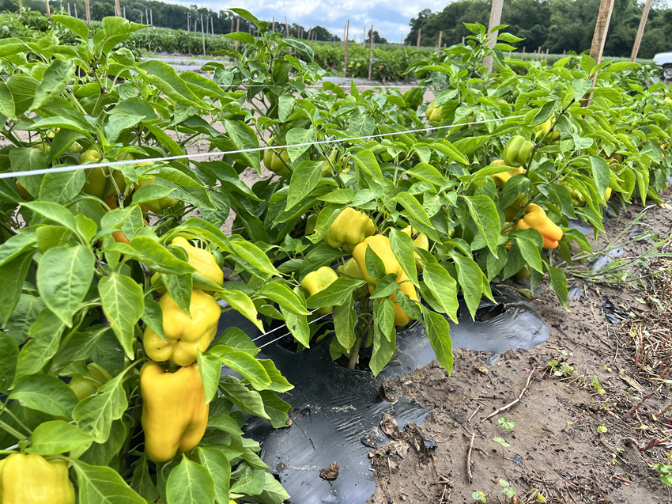
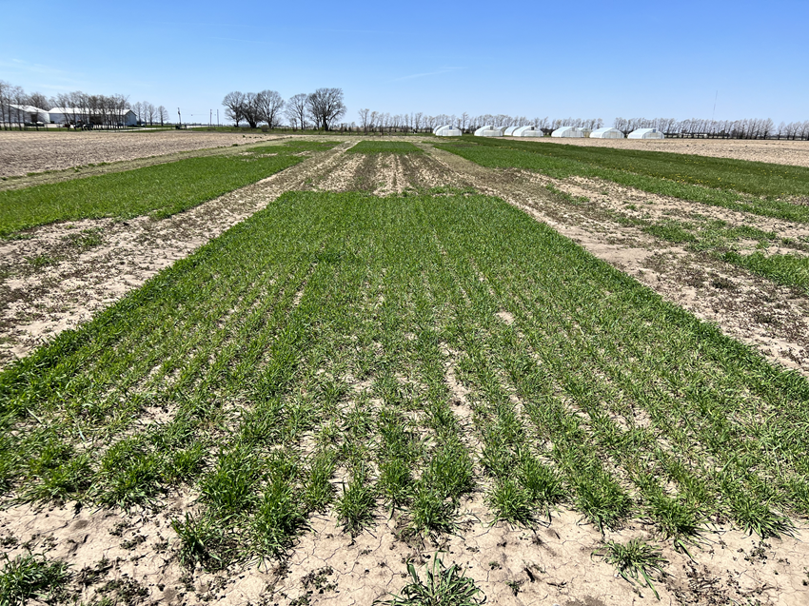
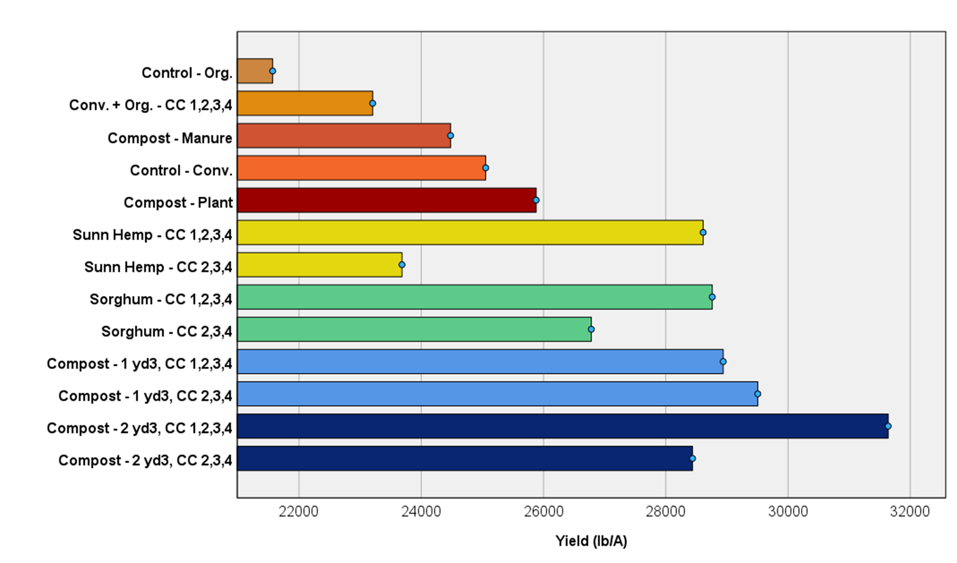
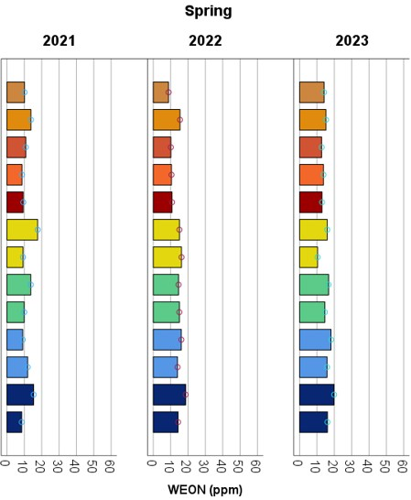
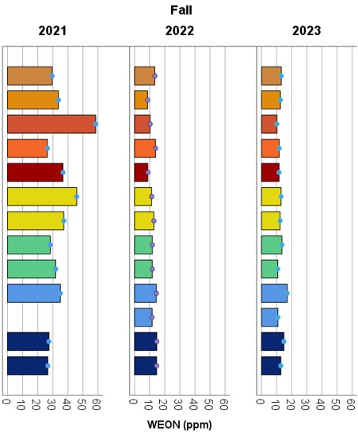
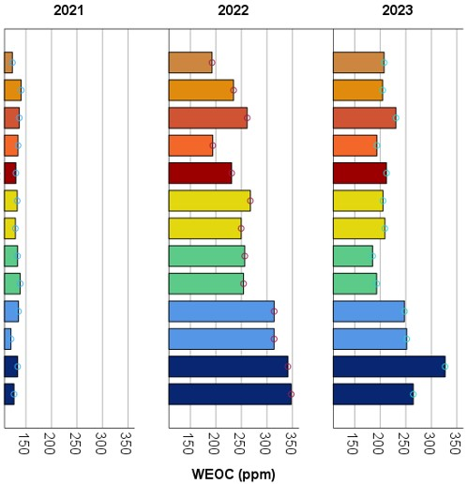
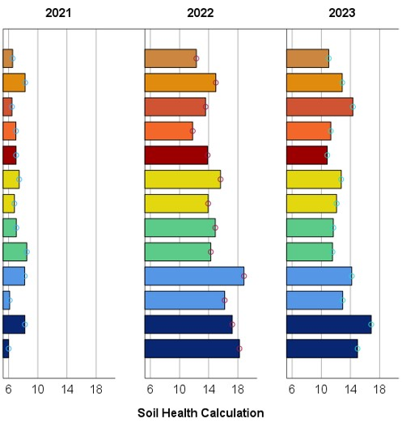

Building Soil Health.
Sustainable Management Approaches to Overcome Production Challenges
Petrus Langenhoven¹ and Nathan Shoaf²
Purdue University. ¹Department of Horticulture and Landscape Architecture, and ²Extension
INTRODUCTION
Just like any other farming system, organic farming systems have limitations. One common issue is that the demand for specific nutrients can exceed the supply available for plant uptake. It is challenging to predict the amount of nitrogen that will be available in the soil at a particular stage of plant growth. Over-applying organic soil amendments, such as composted manure as the sole source of fertilizer input, can result in high nitrate concentrations leaching into groundwater. Compost applications can also contribute to excessive soil phosphorus if added at rates greater than phosphorus removal in the harvested crop. This may diminish the sustainability outcomes of organic farm operations that prefer less reliance on off-farm inputs. The over-application of fertilizer on conventional farms also leads to the leaching of nutrients into the environment.
Regardless of the farming system used, soil fertility cannot be managed independently. Microbial activity and nutrient mineralization are interconnected, and optimizing soil health requires adding a lot of biomass to soils. Cover cropping offers a sustainable solution to building soil health. Among others, it enhances nitrogen cycling within the plant-soil system by reducing nitrate losses and weed pressure in subsequent cash crops. This poster discusses the impact of conventional, organic, and mixed soil amendment systems, summer and winter cover cropping, and the application of compost on soil health and pepper yield at the Throckmorton/Meigs Purdue Ag Center in Lafayette, Indiana.
HANEY TEST
The test uses unique extracts (H3A organic acid) to determine nutrient quantities. The results indicate the amount of food that is readily available to soil microbes and is sensitive to measuring root exudates and decomposed organic material.
MATERIALS AND METHODS
Spring and fall soil samples were submitted for soil health testing (Haney test) at Brookside Laboratories (OH). A total of fifteen 6-inch deep soil cores were taken per experimental unit. One composite sample was then submitted for analysis. All soil amendments were applied preplant. Soil and compost test results were used to adjust and standardize N, P, and K soil nutrient levels across all treatments. Targeted fertility amendment application rates are shown in Table 1.
Plant and manure-based compost applications ranged between 1 – 2 ft³ per 20-foot bed (80 - 160 yd³/A), respectively. Soil amendments were placed in the bed row before raised beds were made. The raised beds were covered with a plastic mulch. Treatments receiving a plant and manure compost mix were broadcasted at 1 yd³/400 ft² and 2 yd³/400 ft² (109 yd³/A and 218 yd³/A), respectively, before raised beds were made. Summer cover crops were planted only in YR 1. In YR 3, buckwheat was seeded in bed row middles and will also be seeded in 2024.
EXPERIMENTAL DESIGN
Randomized Block Design with 13 treatments (Table 2), replicated three times. An experimental unit covers 400 ft². A pepper crop was planted on three 20-foot. bed rows per experimental unit.
Table 2. Treatment combinations evaluated
Table 1. Mean target soil fertility amendment application rates.
Treatment | Description | Fall/Winter Cover Crop (CC)
 |  | 1 | 2 | 3 | 4
Control | Org. Nutrients | - | - | - | -
Control | Conv. Nutrients | - | - | - | -
Compost | Plant based | - | - | - | -
Compost | Manure based | - | - | - | -
Compost | 1 yd³/400 ft² | - | X | X | X
Compost | 2 yd³/400 ft² | - | X | X | X
Sunn Hemp | Legume | - | X | X | X
Sorghum | Biomass | - | X | X | X
Compost | 1 yd³/400 ft² | X | X | X | X
Compost | 2 yd³/400 ft² | X | X | X | X
Sunn Hemp | Legume | X | X | X | X
Sorghum | Biomass | X | X | X | X
Conv. + Org. Nutrients |  | X | X | X | X
Year | lb N/A | lb P₂O₅/A | lb K₂O/A
2021 | 135 | 140 | 190
2022 | 120 | 150 | 154
2023* | 100 | 0 | 157
* In 2023, variable rates were applied according to treatment levels.
2021
2021
2021
Conv. + Org. Nutrients
Practices
Plant-based compost
Fig 1. Soil fertility amendments applied pre-plant in bed row before raised bed is shaped.
Fig 2. High weed pressure in 2021. No herbicides were applied.
Fig 3. Hand weeding between plants within beds and flail mowing between beds.
Fig 4. Weeds depleted nutrients in treatments with low nitrogen supply.
2022
2023
Adopting New Practices
Fig 5. Plastic mulch and Dual Magnum® used to protect nutrients and control weeds (grass)
Fig 6. Buckwheat planted in row middles.
Fig 7. Crop yield improved significantly with adopted practices.
Fig 8. Fall/Winter cereal rye and hairy vetch cover crop treatments.
P = <0.001
P = 0.002
P = 0.002
P = <0.001
P = 0.020
RESULTS
Fig 9. Means of 2022 and 2023 marketable yield.
Fig 10. Spring Water Extractable Organic Nitrogen (10 – 30 ppm is desired).
Fig 11. Fall Water Extractable Organic Nitrogen (10 – 30 ppm is desired).
Fig 12. Water Extractable Organic Carbon (100 – 300 ppm is desired).
Fig 13. A soil health calculation between 7 and 30 is desired.
DISCUSSION
Nutrient losses in 2021 from heavy rainfall events and weed pressure required changes to management practices in subsequent years. The preplant application of Dual Magnum® provided effective grass control, and the plastic mulch protected the applied soil amendments and existing soil fertility. Soil health improved in 2022 by between 67 and 202%. On average, soil health in 2023 declined by 14%. This is due to a sharp decline in WEON levels and a slight decline in WEOC, which increased the C:N ratio and resulted in lower soil respiration (microbial activity).
Compost (1 yd³ and 2 yd³) and cover crop treatments did contribute to carbon loading. Summer cover crops, in combination with a fall/winter cover crop planted in YR 1, 2, and 3, had a similar positive effect on crop yield compared to the 1 yd³ and 2 yd³ compost treatments. Growers who take land out of production and plant cover crops will obtain similar benefits as those who apply high rates of compost. However, compost could be an expensive carbon source, and over-application could harm the environment.
ACKNOWLEDGEMENTS
USDA NIFA for funding our proposal titled “Taking the next step as a small and medium-sized farm: Understanding the integration of production, food safety, and profitability. “ Award Number: 2021-68006-33893.
Visiting scholars working on this project are Lian Duron Alvarado, Eduardo Miranda Oviedo, and Dennis Gustavo Toc Mo.

